Slide 1


Western Countries Financial Data Analysis
Presented By –
Bhagyashri Ashok Pachpute

Slide 2




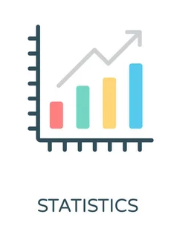
Agenda
Data Exploration
Statistical Analysis using Excel
Graphical Analysis using Excel
Insert the given data into the SQL server
Import the Data from the SQL Database into Power Bi
Interactive Dashboard by using visualization tools
Conclusion and Inferences
References/Links

Slide 3

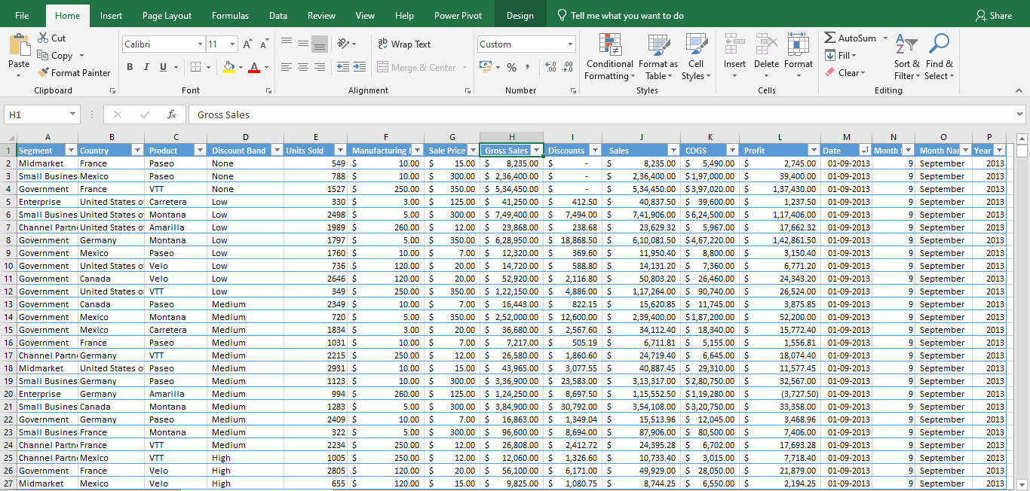
Data Exploration
Read and understand the data by exploring in excel.
There are 16 columns and 701 rows containing financial data of western countries.
Segment, country, sales, profit, etc are the key columns in dataset.
Data exploration includes data cleaning, removed duplicate values, fill the null values.

Slide 4
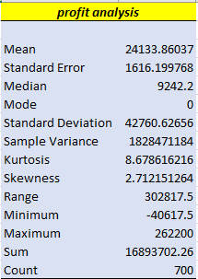
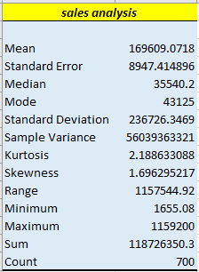
Statistical Analysis using Excel
Excel is a useful in statistical analysis
It provides tools which made easy to do statistical analysis.
With the help of descriptive statistics function, I can explore and derived statistical insights from the dataset

Slide 5
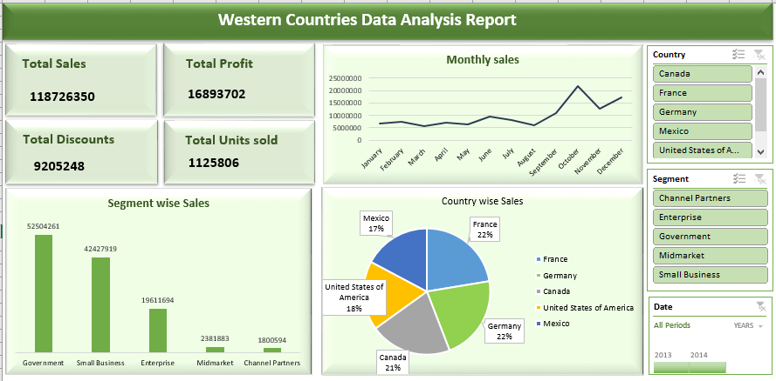
Graphical Analysis using Excel

Slide 6

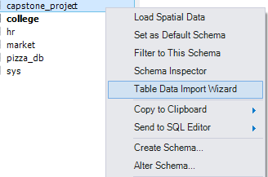
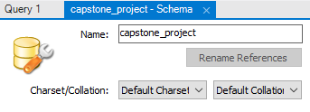

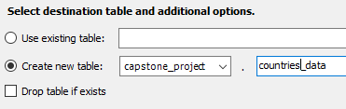
Insert the given data into MySQL Workbench
Create new schema
Import data from csv file
Run some basic query to check whether the data import successfully

Slide 7
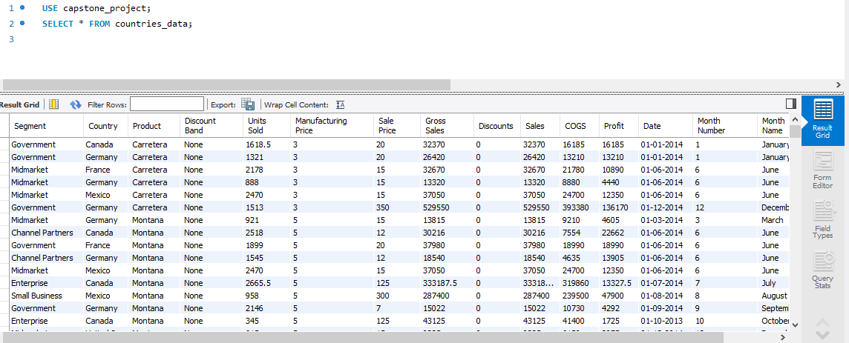
Data import successfully in SQL

Slide 8
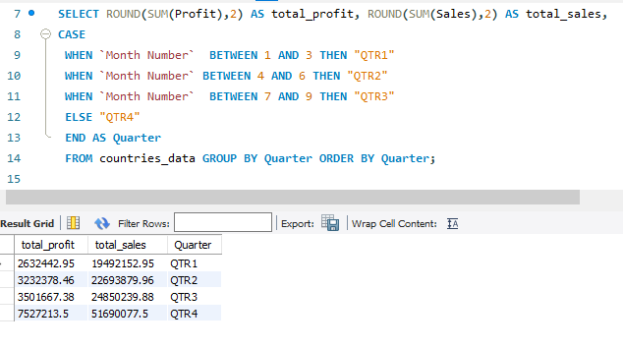
Try case function to derived monthly sales and profit in the form of quarters

Slide 9
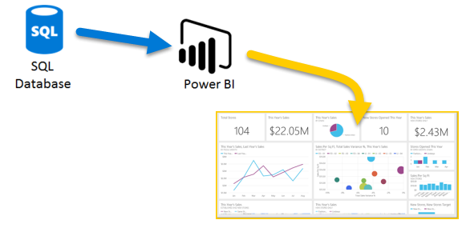
Import the Data from the SQL
Database into Power BI
Launch Power BI in my device.
Click "Home" > "Get Data" and select
“SQL Server”.
Enter server details, choose a database, and select the table.
Click "Load" to import data.
Switch to "Report" view to create visualizations.

Slide 10

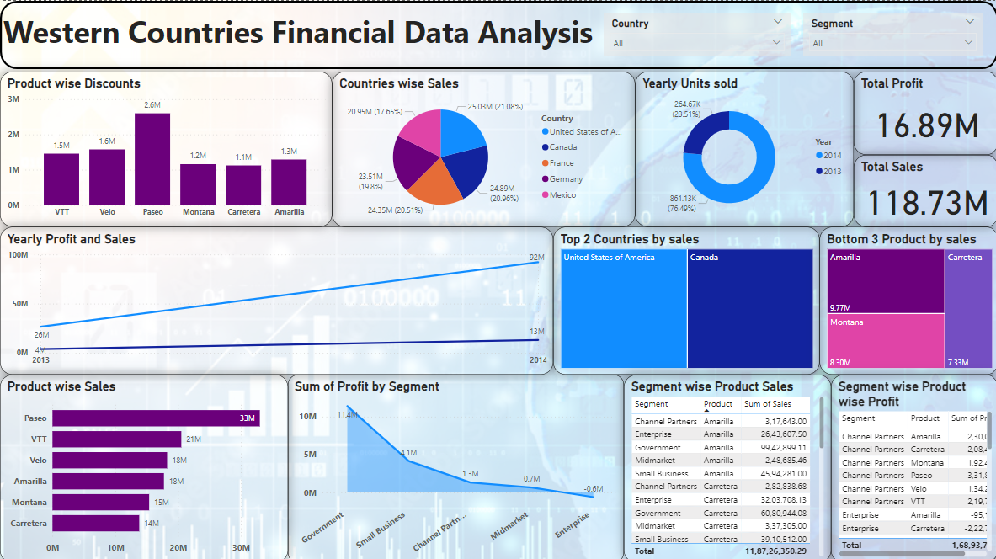
Interactive Dashboard by using visualization tool - Power BI

Slide 11
Conclusions & Inferences
The financial data of western countries shows tremendous growth in 2014.
Sales and eventually profit grew significantly from 2013 to 2014, indicating positive business performance.
USA records dominate in sales, surpassing other countries, highlighting a strong market presence.
Paseo product holds a significant market share, indicating its popularity or strategic positioning.
December stands out with the highest sales, suggesting a potential seasonal trend or marketing impact.
Government segment exhibits higher sales, indicating a lucrative market in this sector.
United States and Canada emerge as the top two countries in terms of sales, showcasing their economic significance.
Carretera, Montana, Amarilla ranks as a bottom three products in sales, indicating potential areas for improvement and strategic revolution.

Slide 12

Data analysis using Excel -
https://docs.google.com/spreadsheets/d/16IRbPJF59_tkacuI87gQs5a4hbVCDk9Z/edit?usp=sharing&ouid=102554264024701286892&rtpof=true&sd=true
References/Links
Interactive dashboard using Power BI -
https://drive.google.com/file/d/1bOlpiBkhfpUR_AHJk7W8gUy4ZOwCnp1J/view?usp=sharing

Slide 13
THANK YOU
bhagyashri.pachpute225@gmail.com

